Slide 1



Frequently Asked Questions?
(TECHNICAL)

Slide 2
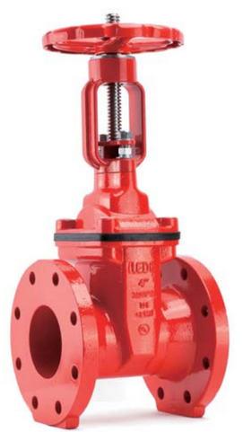

How many bolt holes do Flanged Gate Valves have for different sizes?
According to the ASME B.16.1 Class 150 Flange Standard, the following are the bolt holes:
LEDE OS&Y Gate Valves
2-½ inch & 3 inch - 4 bolt holes
4 inch, 6 inch, 8 inch - 8 bolt holes
10 inch & 12 inch -12 bolt holes
QUICK TIP
Try right clicking on a photo and using "Replace Image" to build your own flash cards..

Slide 3
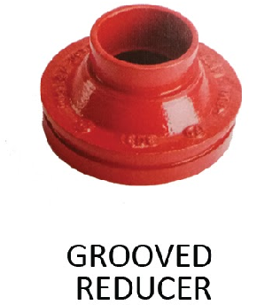
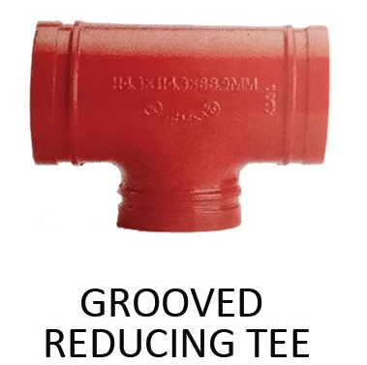
What is the difference between Grooved Reducer and Grooved Reducing Tee?
GROOVED REDUCER
A grooved reducer is a pipe fitting that looks like a cone and is used to connect two pipes of different sizes in a pipeline with grooved ends. It reduces the pipe size.
GROOVED REDUCING TEE
A grooved reducing tee is a fitting that combines three pipes at a tee junction, and one of the branches has a smaller diameter, providing a reduction in size at that specific branch.
QUICK TIP
Try right clicking on a photo and using "Replace Image" to build your own flash cards..

Slide 4
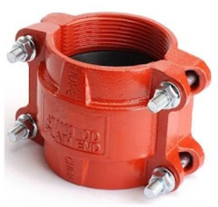
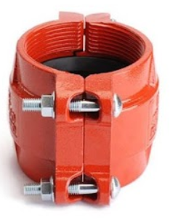
What does the LEDE HDPE coupling do, and where can it be used?
LEDE HDPE coupling features four bolt, teeth, and a shaped housing with ramps for secure grip on pipes, but not PVC pipes. This coupling is specifically designed for use with HDPE pipes, but it should not be used with PVC pipes or other types.
QUICK TIP
Try right clicking on a photo and using "Replace Image" to build your own flash cards..

Slide 5
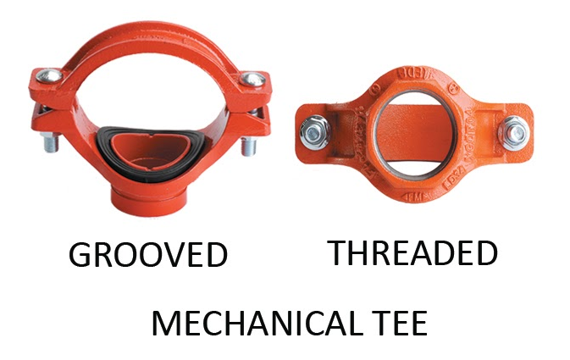
What is the difference between Mechanical Tee Threaded and Mechanical Tee Grooved?
1. Mechanical Tee Threaded
  Connects using threaded connections.
  Requires threading on the pipe ends to screw into the tee.
2. Mechanical Tee Grooved
  Connects using grooved connections.
  Requires grooves on the pipe ends to be mechanically joined to the tee using couplings.
In summary, the distinction lies in the type of connections they utilize – threaded for Mechanical Tee Threaded and grooved for Mechanical Tee Grooved.
QUICK TIP
Try right clicking on a photo and using "Replace Image" to build your own flash cards..

Slide 6
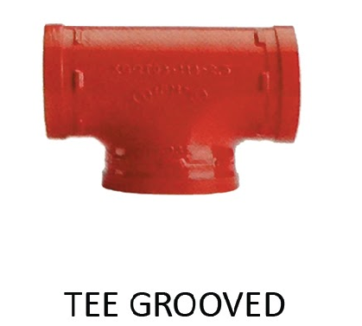
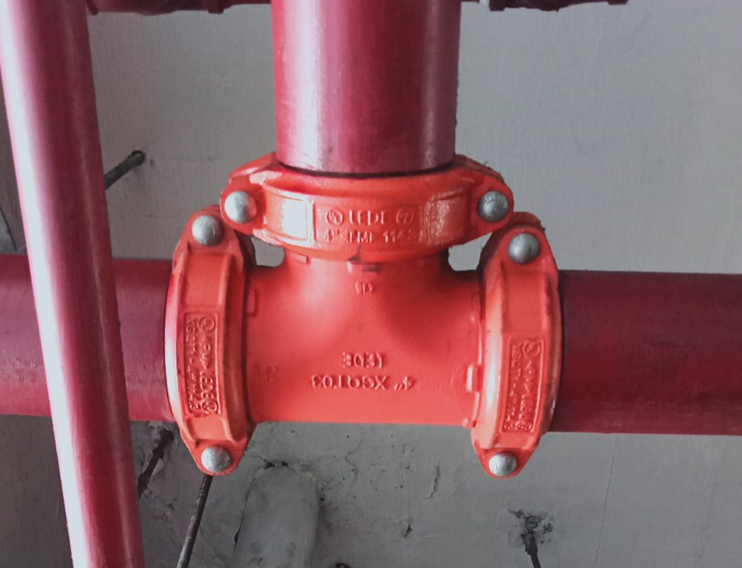
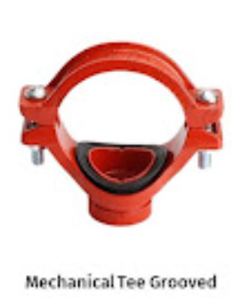
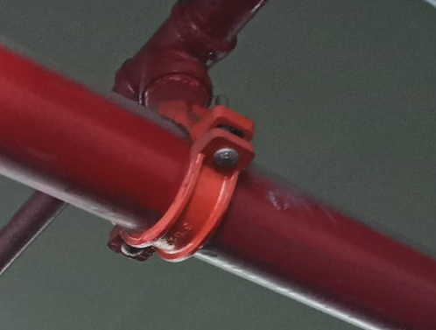
What is the difference between Tee Grooved and Mechanical Tee Grooved?
The main difference between Tee Grooved and Mechanical Tee Grooved fittings lies in their design and installation method.
Tee Grooved fittings have grooves for easy installation using mechanical couplings, while Mechanical Tee Grooved fittings come with an integrated mechanical outlet for a direct connection without the need for a separate coupling.
QUICK TIP
Try right clicking on a photo and using "Replace Image" to build your own flash cards..

Slide 7
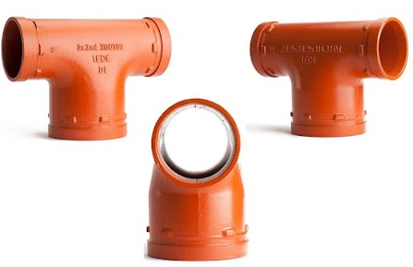
What is Bull Head Tee and where is it typically used?
A Bull Head Tee is a special type of tee with a grooved end. It's used in fire protection systems to split the flow into two smaller branch lines without needing extra fittings like concentric reducers and multiple couplings.
QUICK TIP
Try right clicking on a photo and using "Replace Image" to build your own flash cards..

Slide 8
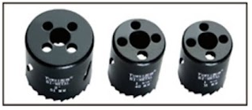
What are the different conversions for your Tuwei Holesaw Blades?
Convention of TUWEI HOLESAW Blades
Holesaw Blade 30mm - ½ inch
Holesaw Blade 38mm - 1 inch
Holesaw Blade 46mm - 1-¼ inch
Holesaw Blade 54mm - 1-½ inch
Holesaw Blade 64mm - 2 inch
Holesaw Blade 73mm - 2-½ inch
Holesaw Blade 92mm - 3 inch
Holesaw Blade 111mm - 4 inch
QUICK TIP
Try right clicking on a photo and using "Replace Image" to build your own flash cards..

Slide 9
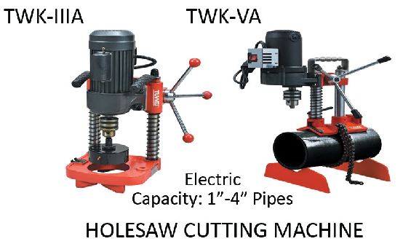
What makes Tuwei Holesaw Machine TWK-IIIA different from Holesaw Machine TWK-VA, besides their capacity and price?
HOLESAW MACHINE TWK-IIIA
TWK-IIIA, weighing 26 kgs, is intended for horizontally boring pipes due to its heavier build.
HOLESAW MACHINE TWK-VA
On the other hand, TWK-VA, with a lighter weight of 17.2 kgs, is more portable and advantageous for vertical and sideways boring of pipes.
QUICK TIP
Try right clicking on a photo and using "Replace Image" to build your own flash cards..

Slide 10
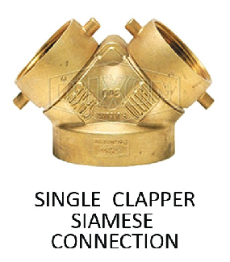
Why do people call the Siamese connection the Fire Department Connection?
The Siamese connection, also known as the Fire Department Connection, is crucial for supplying extra water to sprinkler and standpipe systems during firefighting operations, espicially for large fires requiring additional water.
QUICK TIP
Try right clicking on a photo and using "Replace Image" to build your own flash cards..

Slide 11
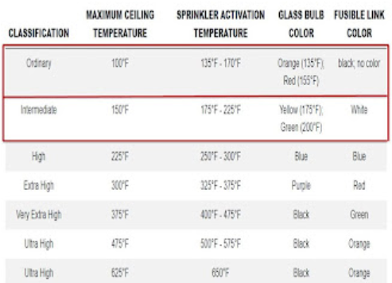
Why do sprinkler heads have different colors? What colors do your sprinkler heads come in?
SPRINKLER HEAD COLORS
Sprinkler heads have different colors to show the temperature at which they release water.
Our sprinkler heads come in Red (68°C or 155°F) and Green (93°C or 200°F).
QUICK TIP
Try right clicking on a photo and using "Replace Image" to build your own flash cards..

Slide 12
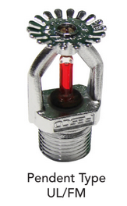
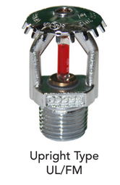
What are your available sprinkler heads, and where are they used?
We have three main types of sprinkler heads.
PENDENT SPRINKLER HEADS
These shoot water downward, covering a wide area because the water is scattered in a cone shape. They are mounted on the ceiling, providing excellent coverage.
UPRIGHT SPRINKLER HEADS
These spray water upward into a space, and then the water is directed downward by deflectors. They are useful in places with obstacles like beams or ducts, and they create a circular spray pattern. They are often used in mechanical rooms or other hard-to-reach areas.
QUICK TIP
Try right clicking on a photo and using "Replace Image" to build your own flash cards..

Slide 13
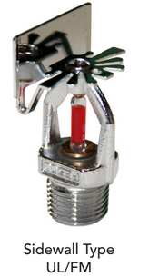
What are your available sprinkler heads, and where are they used?
SIDEWALL SPRINKLER HEADS
Sidewall sprinkler heads, which spray water in a half-circle pattern, are used for wall protection when ceiling sprinklers are not available.
QUICK TIP
Try right clicking on a photo and using "Replace Image" to build your own flash cards..

